Slide 1


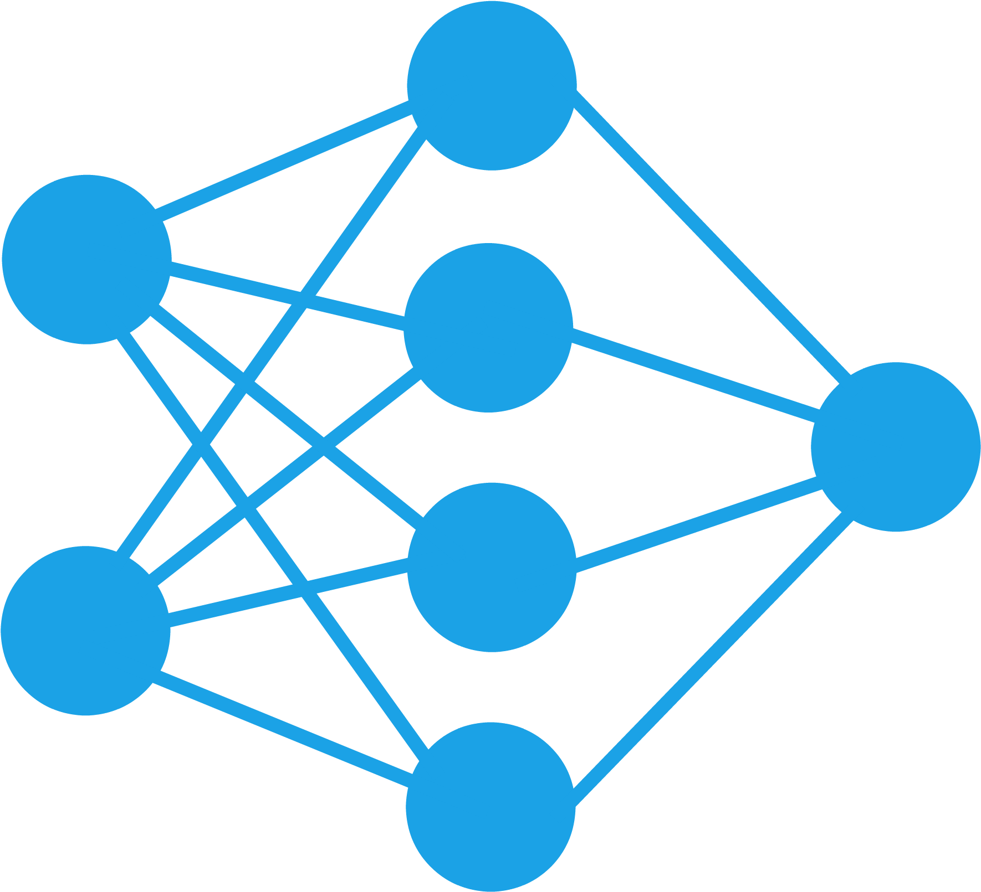
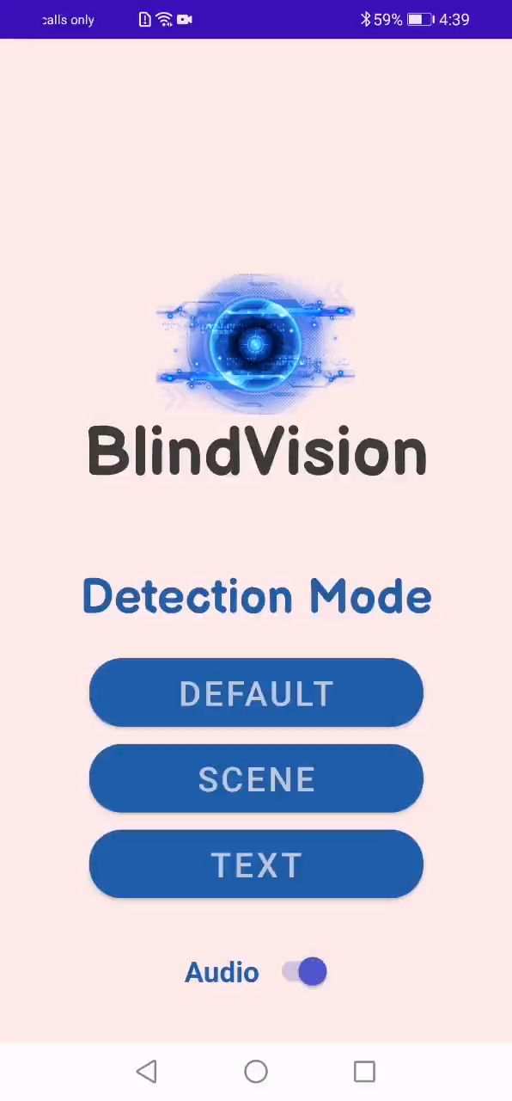
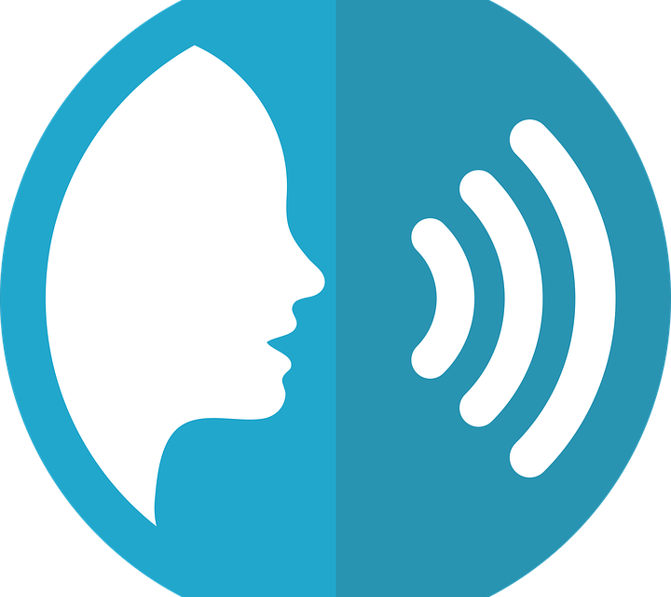






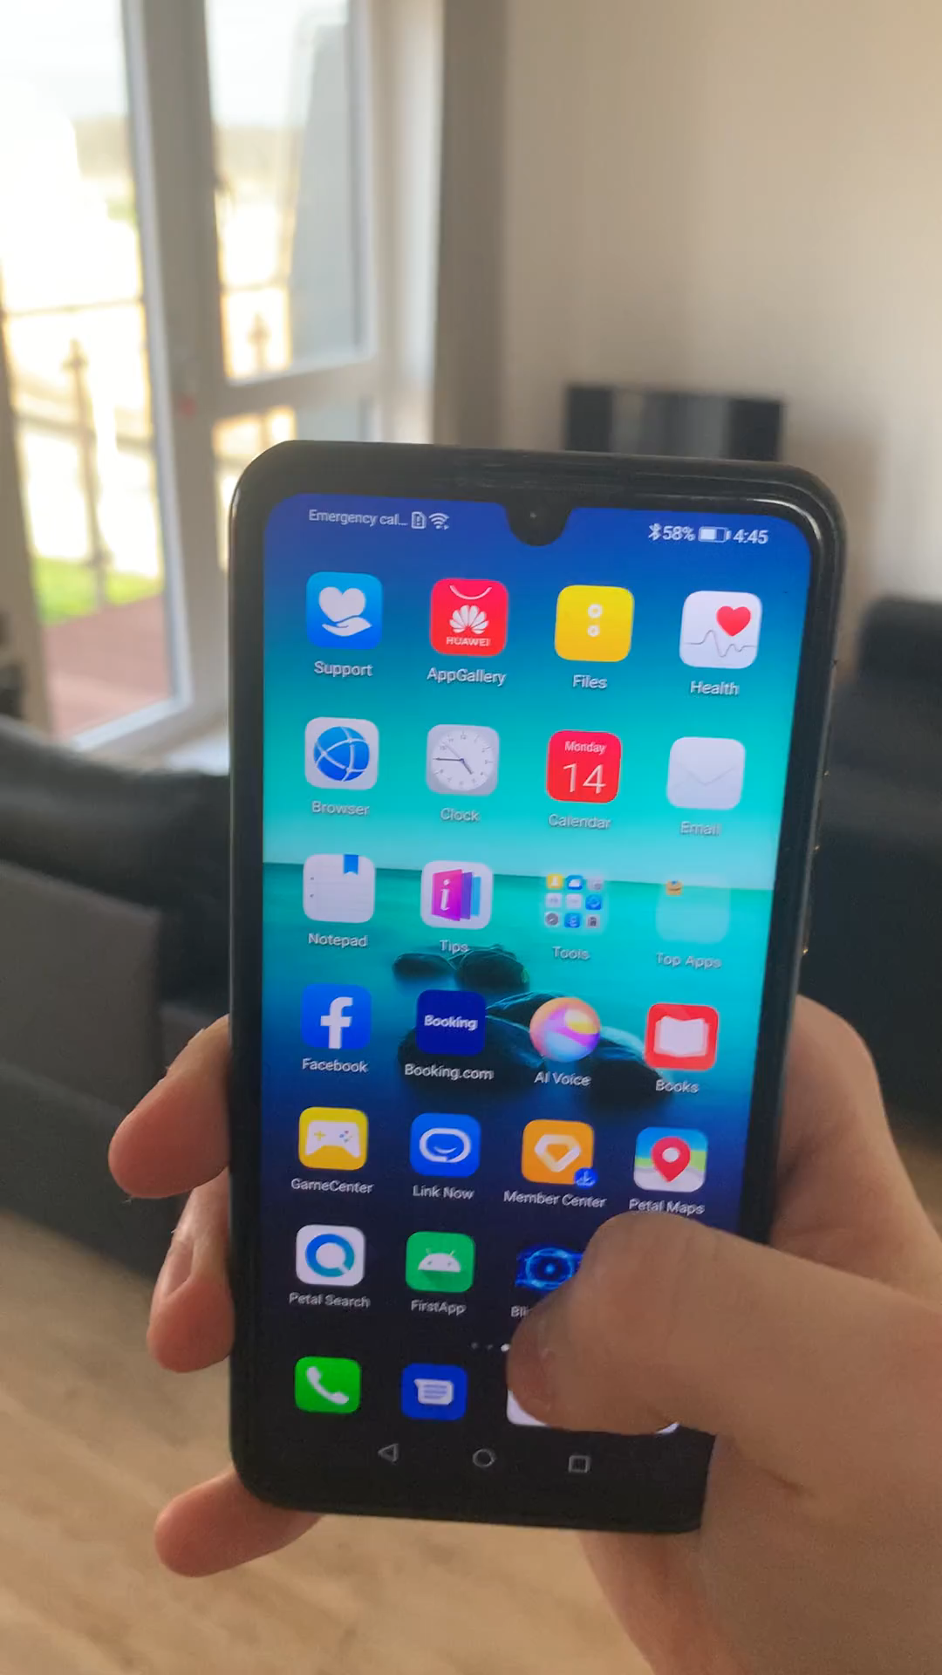
Computer Vision and Speech Synthesis Based Scene Understanding for People with Impaired Vision
Name: Kyriakos Kyriakou Supervisor: Professor John Gan
Background:
Secondary Achievements:
Deep Learning Icon Download Neural Network, Balloon, Sphere Transparent Png – Pngset.com
Vision impairment is a major health problem affecting millions of people around the globe. Scene Understanding is a challenging task for these people.
Using Speech Recognition, the system can understand the user’s commands by voice. Furthermore, system has build-in gestures to make the interaction with the user hands-free.
1*cU0zTmKj2sgMO0HQ05JwSg.png (640×640) (medium.com)
Performance Comparison:
Models (Object Detection) | Mean Accuracy | Avg. FPS
MobileNetV1 | 65% | 14.9
Yolov4 Tiny (via DarkNet API) | 68% | 6.4
EfficientDet_Lite0 | 67% | 14.4
EfficientDet_Lite1 | 68% | 13.7
EfficientDet_Lite2 | 69% | 12.8
EfficientDet_Lite3 | 70% | 12
Technologies Used:
App logo taken from: httpand-blue-eyes-eye-light-science-technology-cliparts://www.jing.fm/iclip/mihox_/
Main Achievements:
Android Studio Logo free download - 750*450, 75.89 KB (subpng.com)
https://www.tensorflow.org/site-assets/images/project-logos/tensorflow-lite-logo-social.png
1200px-OpenCV_Logo_with_text_svg_version.svg.png (1200×1478) (wikimedia.org)
ml-kit-logo.png (1600×468) (bp.blogspot.com)
https://encrypted-tbn0.gstatic.com/images?q=tbn:ANd9GcR1ea8WbzjahTCdCE8Yqg1sBIwxGZ3QPp74hWa6MKKWHQKYm_7dJhMU2XYiJDbx1BYsSNc&usqp=CAU
No Touching Prohibited Forbidden - Free vector graphic on Pixabay
Deep learning for Object detection and Image classification has been combined with Optical Character Recognition, to give an in-depth understanding. Different CNN object detection models have been tested and evaluated. The app can recognize text, people, objects, and give audio explanation of the environment using Text-To-Speech tools.
Goal:
Feature Improvements:
The ultimate goal was to develop an app (“BlindVision”) that uses Computer Vision and Speech Synthesis techniques to help people with impaired vision understand a scene and assist them with their daily tasks.
Introducing new features that will make the interaction with the users better.
New object detection models could be evaluated.
Use Google’s Cloud Vision API for further understanding.
Command given to the system, and then shaking gesture to return to home page (No Audio enabled)

